Slide 1
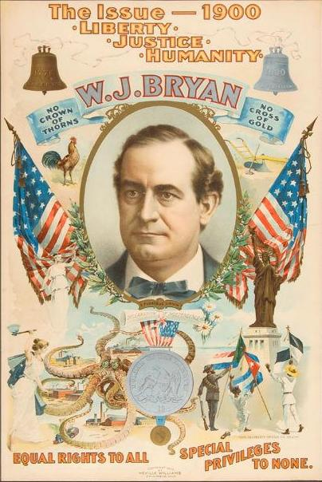
The Growth of Populism
Big Business Faces a Challenge

Slide 2
Populism – “Movement of the people” (as in the common people, like farmers and laborers)

Slide 3
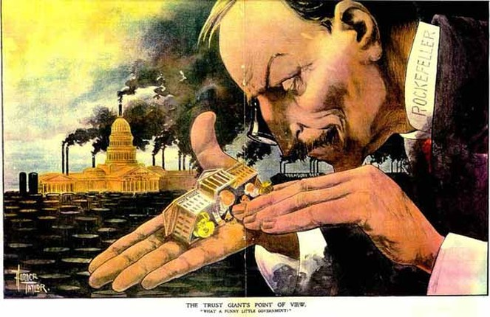
What does this cartoon suggest about the attitude of big business toward government during the Gilded Age?

Slide 4
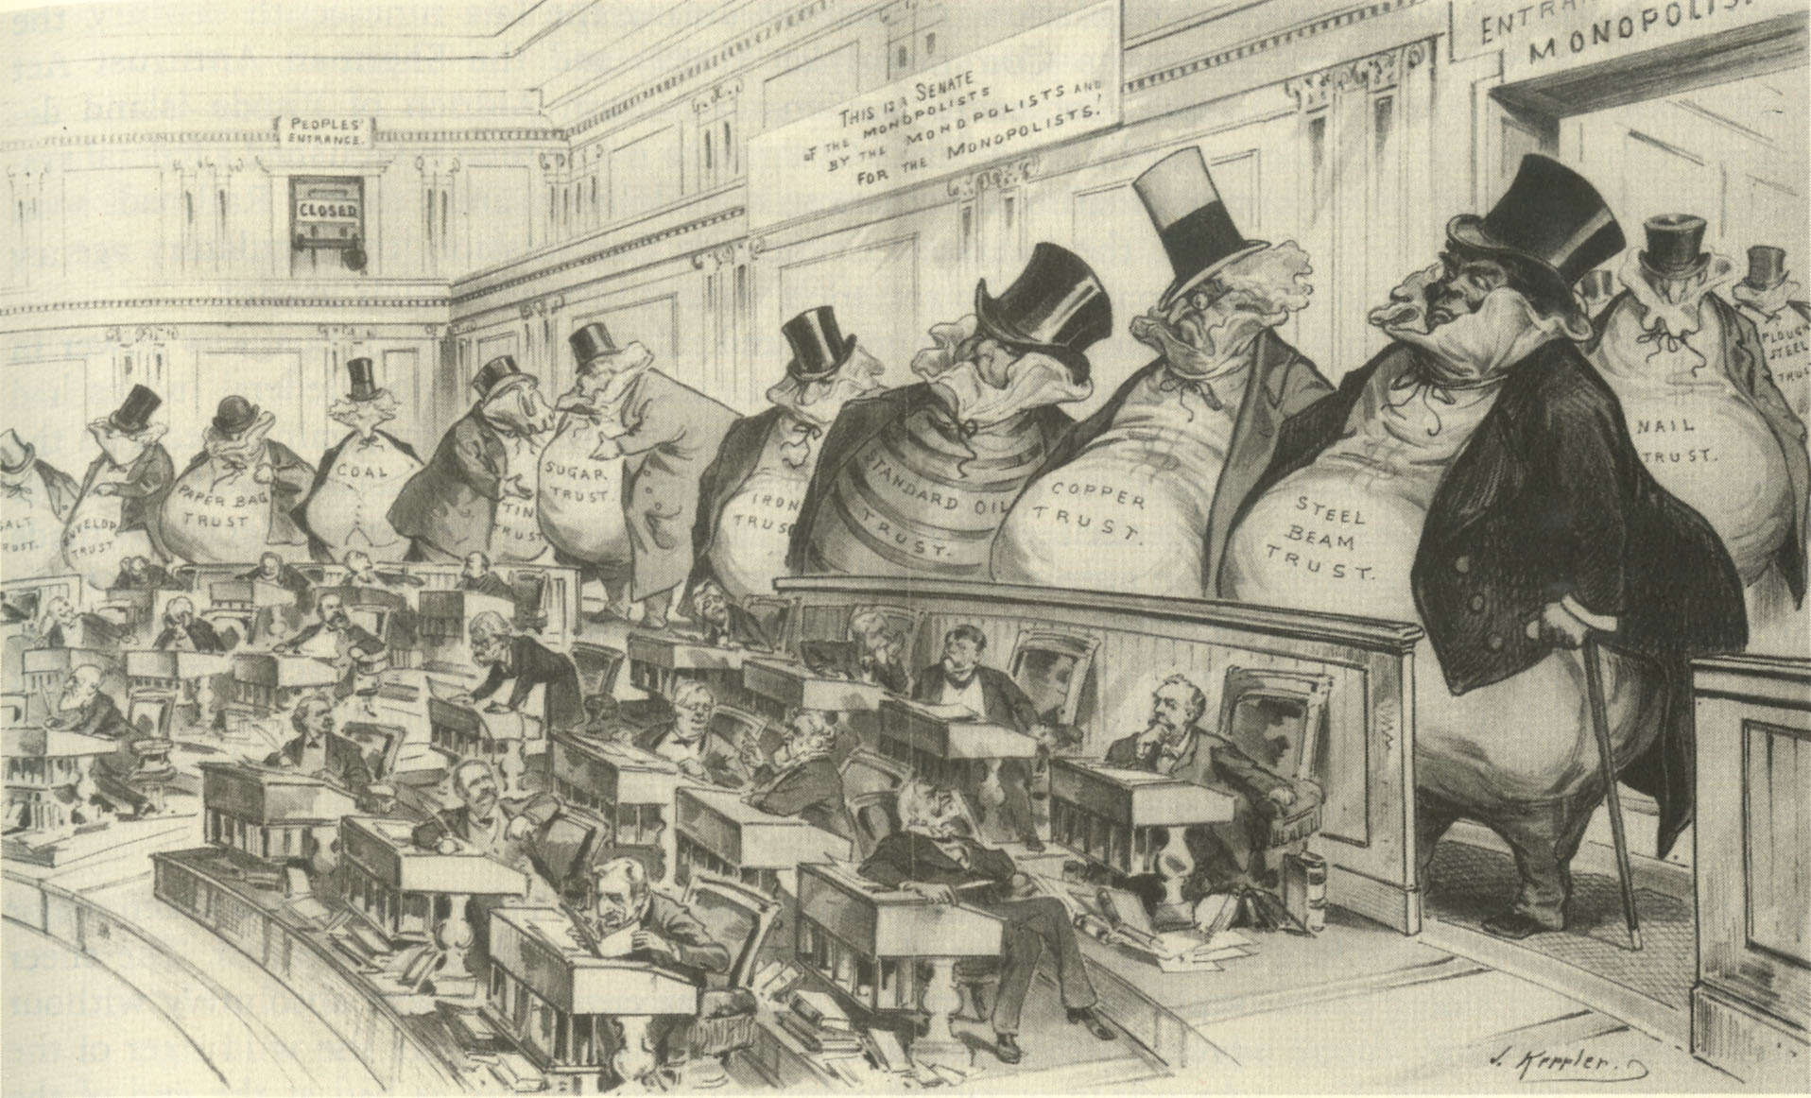
During the Gilded Age, government not only stayed out of the way of big business, it protected it. Why?

Slide 5
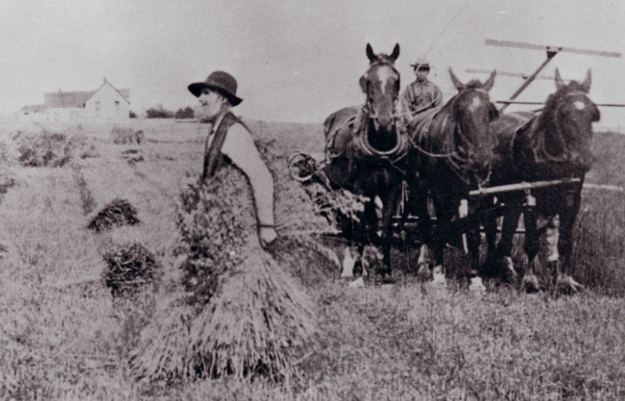
American farmers had problems. As they grew more crops, prices went down. Railroads also overcharged them to ship their goods. Farmers went into debt. Many had to sell their farms and move to the cities for work.

Slide 6
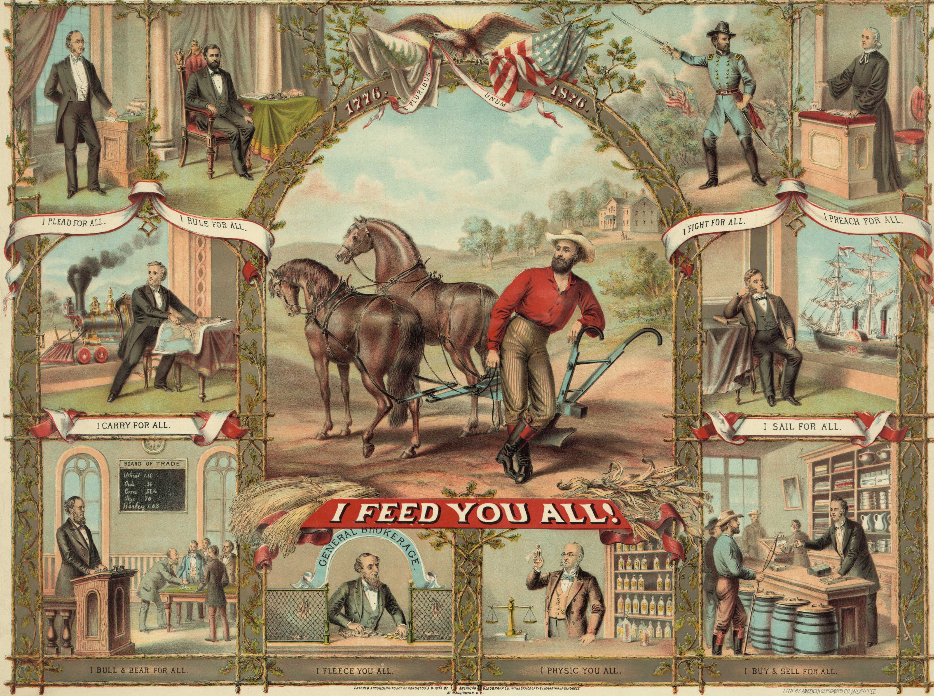
Growth of Populism
Farmers started small. Organizations like The Grange helped farmers work together locally, sharing expensive new equipment.
The Grange

Slide 7
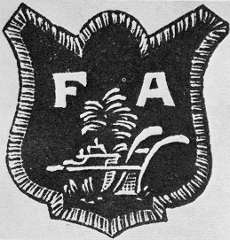
Growth of Populism
Eventually they formed larger organizations known as Farmers’ Alliances. These helped farmers gain political power so they could fight the railroads and banks.
The Grange
Farmers’ Alliances

Slide 8
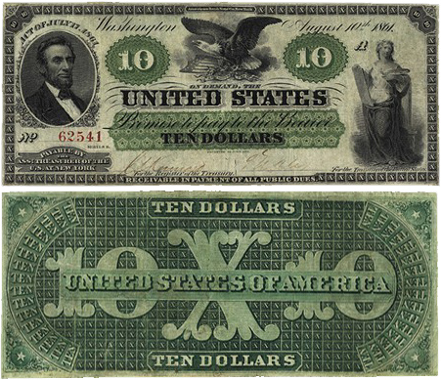
Growth of Populism
Farmers still shared one big problem – DEBT. Money was scarce because it was based on gold. Prices were low, so it was hard for them to sell enough crops to pay off debt. Some farmers joined Greenback parties that wanted the government to print more paper money like they did during the Civil War. This would cause inflation.
The Grange
Greenback Parties
Farmers’ Alliances

Slide 9
What is Inflation?
Inflation is when the value of currency (money) goes down, and prices are “inflated” or go up. Printing more money causes inflation.
Inflation is good if you sell things, because the higher prices mean you make more money.
Inflation is good if you are in debt, because it means you can pay your debt off faster.
Inflation is bad if you loan money, because that money will be worth less when it gets paid back.

Slide 10
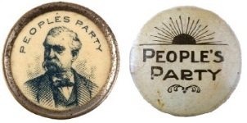
Growth of Populism
Eventually, farmers joined other workers and formed the People’s (or Populist) Party. This party wanted the government to make many changes. They ran their own candidate for president in 1892, but lost.
The Grange
Greenback Parties
Farmers’ Alliances
Populist Party
(1892)

Slide 11
Election of 1892
Grover Cleveland – Democrat – 277 Electoral Votes – 46%
Benjamin Harrison – Republican – 145 Electoral Votes – 43%
James Weaver – Populist – 22 Electoral Votes – 9%

Slide 12
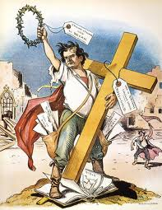
Growth of Populism
Realizing they would never win as a third party, most populists supported the Democratic Party in the election of 1896 because their candidate for president – William Jennings Bryan – promised to add silver to the gold supply to help cause inflation.
The Grange
Greenback Parties
Farmers’ Alliances
Populist Party
(1892)
Democratic Party (1896)
William Jennings Bryan

Slide 13
 | Gold Bugs | Silverites
Who They Were | bankers and businessmen | farmers and laborers
What They Wanted | gold standard less money in circulation | bimetallism more money in circulation
Why | Loans would be repaid in stable money. | Products would be sold at higher prices.
Effects
DEFLATION
Prices fall.
Value of money increases.
Fewer people have money
INFLATION
Prices rise.
Value of money decreases.
More people have money.

Slide 14
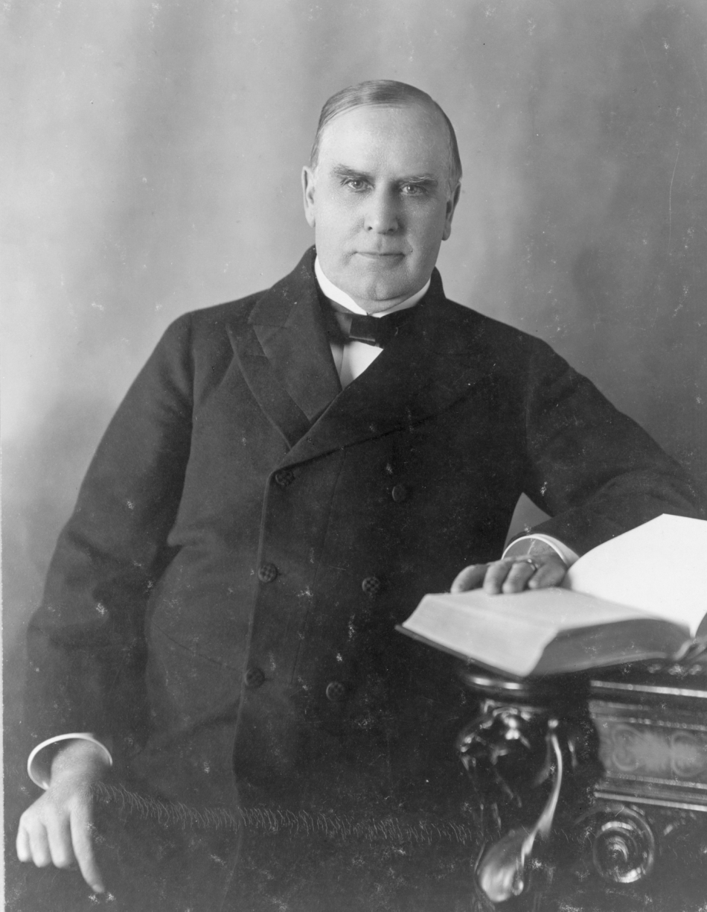
Election of 1896
William Jennings Bryan (D)
William McKinley (R)

Slide 15
“Cross of Gold” Speech
“If they dare to come out in the open field and defend the gold standard as a good thing, we shall fight them to the uttermost, having behind us the producing masses of the nation and the world. Having behind us the commercial interests and the laboring interests and all the toiling masses, we shall answer their demands for a gold standard by saying to them, you shall not press down upon the brow of labor this crown of thorns. You shall not crucify mankind upon a cross of gold!” William J. Bryan - 1896

