Slide 1
The Cold War Continues
LEAD-UP TO THE VIETNAM WAR

Slide 2
The Election of 1960
In 1960, Eisenhower’s vice president Richard Nixon ran for president against John F. Kennedy.
Nixon lost the election, in part, because Kennedy looked much better on TV!

Slide 4
The Cold War Continues
Eisenhower warned that if allowed to spread, countries in Asia would fall like dominos – one after the other – to communism.
Eisenhower had relied mostly on nuclear weapons to contain communism.

Slide 5
The Cold War Continues
Kennedy argued that Eisenhower had let the rest of the military grow too weak.
In 1959, communists under Fidel Castro successfully took over control of Cuba after a revolution.
Shortly after becoming president, Kennedy decided to go ahead with a plan that had been in the works to let Cubans try and recapture Cuba from the communists.

Slide 6
The Cold War Continues
The attack, centering on the Bay of Pigs, was a disaster. Fighters trying to recapture Cuba were stuck using outdated weapons from WWII, and received no American military backup.
Kennedy was humiliated, and Cuba’s communist leadership was furious.

Slide 8
The Cuban Missile Crisis
When the leader of the USSR, Nikita Khrushchev, offered to place medium range ballistic (nuclear) missiles in Cuba, Castro accepted.
Having these missiles would mean that America would be much less likely to attempt another attack on Cuba, like the Bay of Pigs.

Slide 9
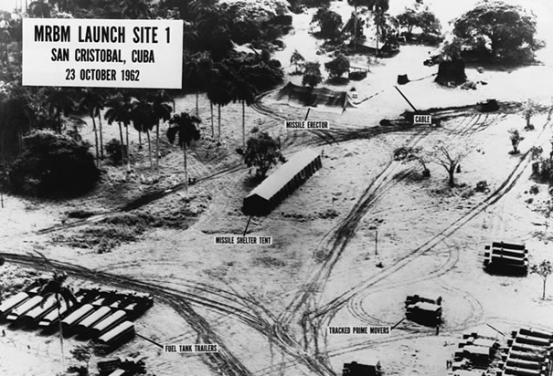
The Cuban Missile Crisis
American spy planes soon discovered the missiles, and President Kennedy was briefed on the situation.

Slide 10
The Cuban Missile Crisis
Your Options:
Do nothing; ignore the missiles in Cuba.
Open direct negotiations with Khrushchev and ask that the missiles be withdrawn.
Order a blockade of Cuba until the missiles are removed.
Send a warning to Castro and Khrushchev that if the missiles are not removed within 24 hours, an airstrike would be ordered to destroy them.
Order an airstrike against the missile sites with no prior warning.

