Slide 1
“Big History” (?)
AP World History

Slide 2
Cosmic Timeline (Based on an Evolutionary Perspective)
Age of the Universe: 8 to 16 billion years (13.4)
The age of the earth/solar system: 4.5 billion years
Mass Extinctions: at least 2
Appearance of the Hominids:2 to 6 million years ago

Slide 3
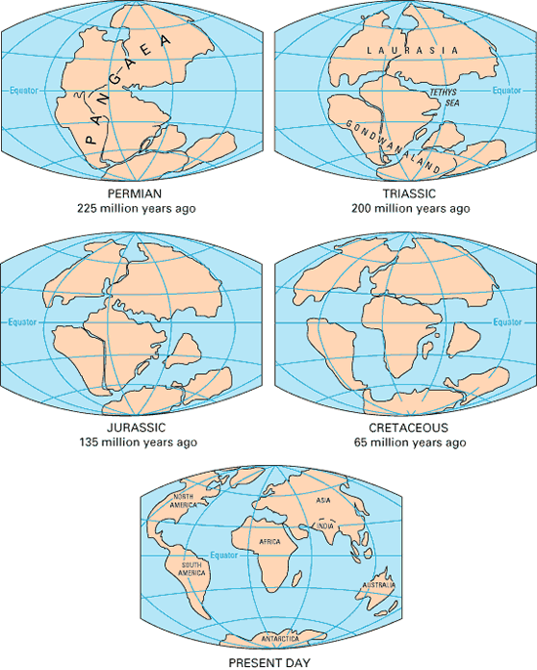

Slide 5
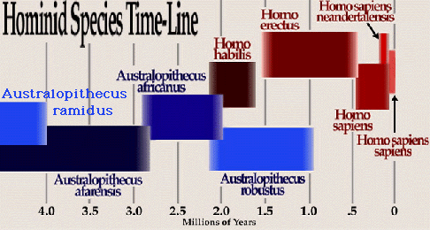

Slide 7
Appearance of Modern Humans
100,000 years ago (by 30,000 years ago), hominids have been replaced by “Modern Humans”
Two Theories:
“Multiregional continuity“ model- after hominids(mostly homo erectus) leave Africa, then these regional pops developed into modern humans
“Out of Africa” model (homo sapiens arose in Africa, then spread throughout the world)
First civilizations: 7000 to 5000 years ago

Slide 8
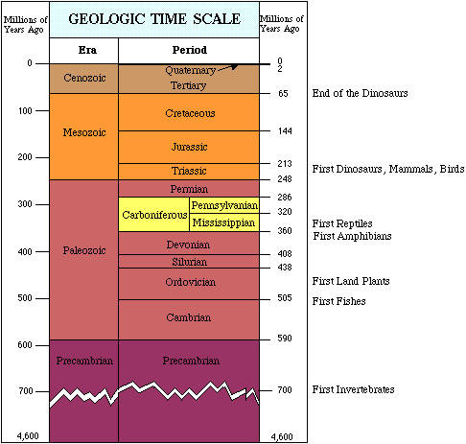

Slide 9
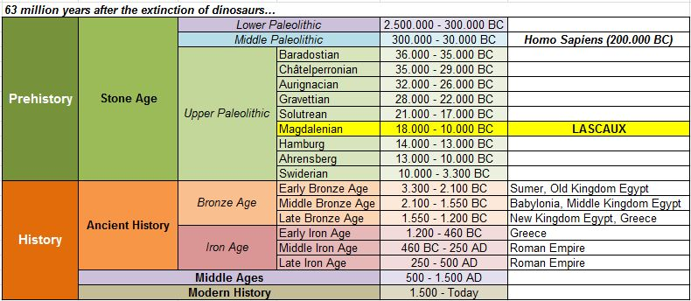

Slide 10
Why So Long?
Outside of a biblical worldview, the vast size of the universe and the way things appear and move now lead many to believe that this has always been the case, thus requiring a very long timeline.
Stuff looks “old” so it must be “old,” right?

Slide 11
Why So Long?
Evolutionary biology requires an extremely long timeline to “work” in theory, leading many to accept and defend the long cosmic timeline.
Evolution requires a really long time, so the earth must be really old. And the earth is really old, because obviously evolution happened and it takes a really long time.
Wait, huh?

Slide 12
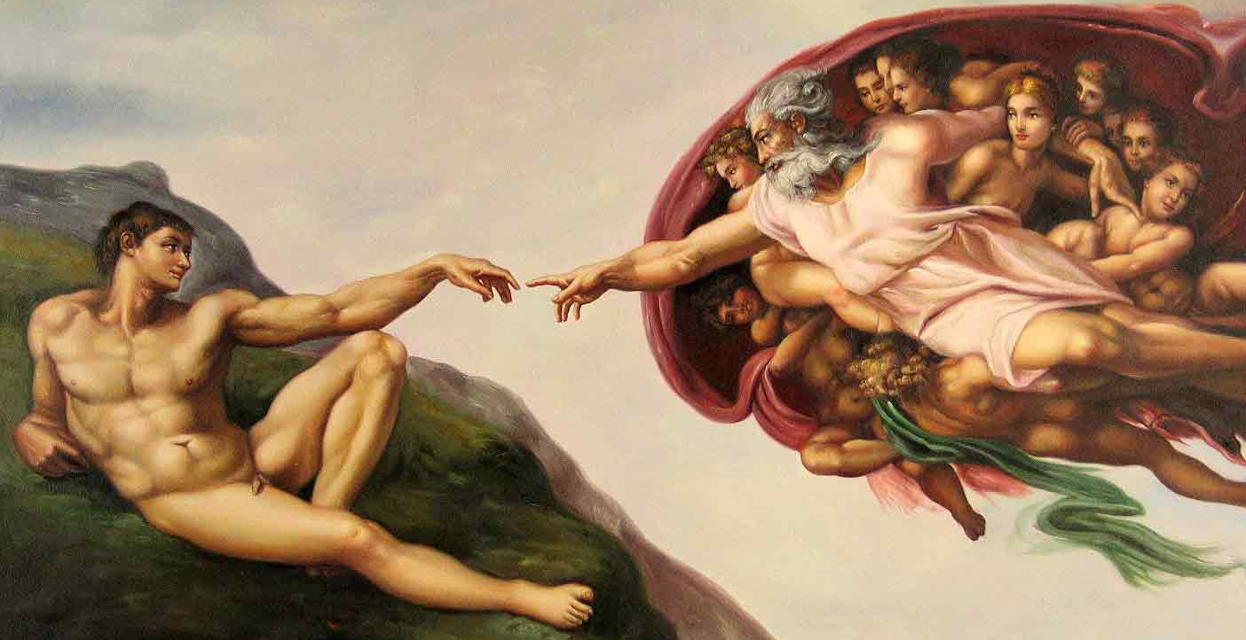
The Word
“In the beginning, God created the heavens and the earth.”

Slide 13
Some questions to consider:
Did God “need” 6 days to create the universe, the earth, and everything in and on them?
Did God “need” to rest on the 7th day?
Could God have created everything instantaneously if He really wanted to?
Mark 2:23-27
How big is your God? Is He truly omnipotent?

