Slide 1
Software Basics
Computer Literacy Unit 2

Slide 2
What is software?
The programs or other operating information used by the computer.
The “instructions” that tell the computer what to do.

Slide 3
What is Firmware?
Firmware is software that is built-into electronic devices and provides the instructions to make them work.

Slide 4
Where is Firmware?
Firmware can be found inside nearly all electronics today – anything “digital,” from computers and smart phones to printers, copiers, wireless routers, DVD and Blu-Ray players, “Smart” TVs, etc.

Slide 5
What is a “BIOS”?
“Basic Input/Output System”
Built-in firmware that starts up other processes in a computer – especially the operating system (like Windows, Mac-OS, i-OS, Android, etc.)
Stored in a small chip on the motherboard.

Slide 6
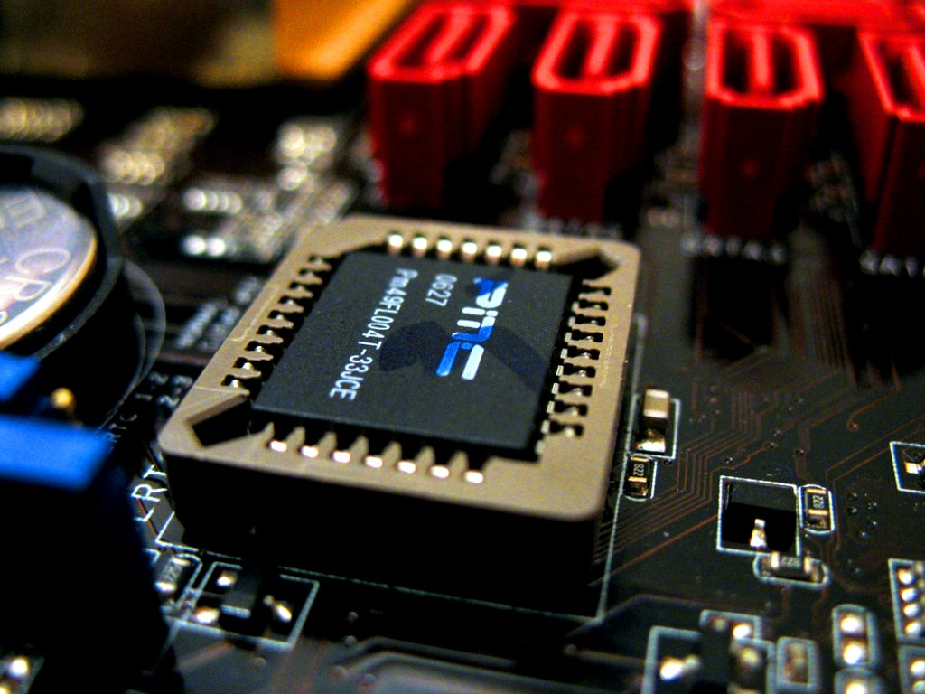
a Desktop BIOS

Slide 7
Types of Software
Operating Systems – software that serves as the “foundation” that other applications use to run and interact with the computer and its parts.
Common OS’s include Windows, Mac-OS, iOS, Android, and Linux.

Slide 8
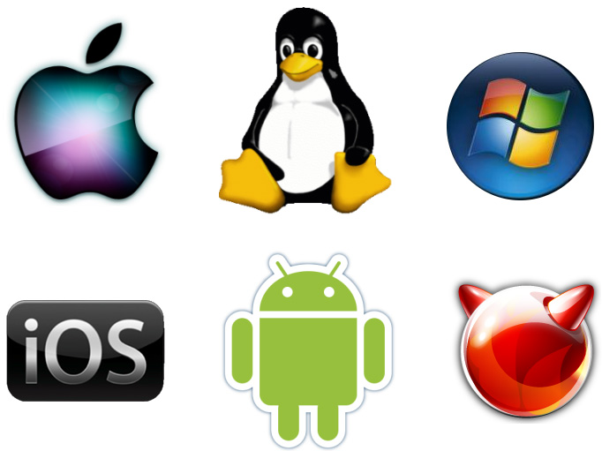
Operating Systems

Slide 9
Applications
Applications are the different programs that run on the Operating System that allow you to use the computer for different things.
Microsoft Word, PowerPoint, Excel, various games like Skyrim, communication apps like Skype, etc.

Slide 10
Applications

Slide 11
What is Malware?
Malware is annoying or destructive software, like a computer virus.
Often installed without the user knowing about it, like clicking on a link in a strange email or installing a program downloaded from an untrusted source.

Slide 12
What is bloatware?
Bloatware is annoying, unnecessary software that usually comes pre-installed on computers and phones when you buy them new.
Can also be installed at the same time as another program that you actually want to install.
Can slow your computer down.

Slide 13
What’s a Trojan Horse?
A Trojan Horse is a virus that allows a hacker to access your computer without you knowing it.
Some even allow a hacker to use your webcam without your knowledge, and add to, change, or delete your files.

Slide 14
Software “Coding”?
“Coding” means writing the instructions that allow software to work. Computers can only do what they are told, so someone has to tell them what to do. That person is the computer programmer.

Slide 15
Software “Coding”?
Programmers write these instructions in various coding languages that are designed to make giving the computer instructions easier.
Code languages provide “shortcuts” that prevent having to write much longer amounts of instructions.

