Slide 1
Vietnam
BACKGROUND OF THE WAR

Slide 2
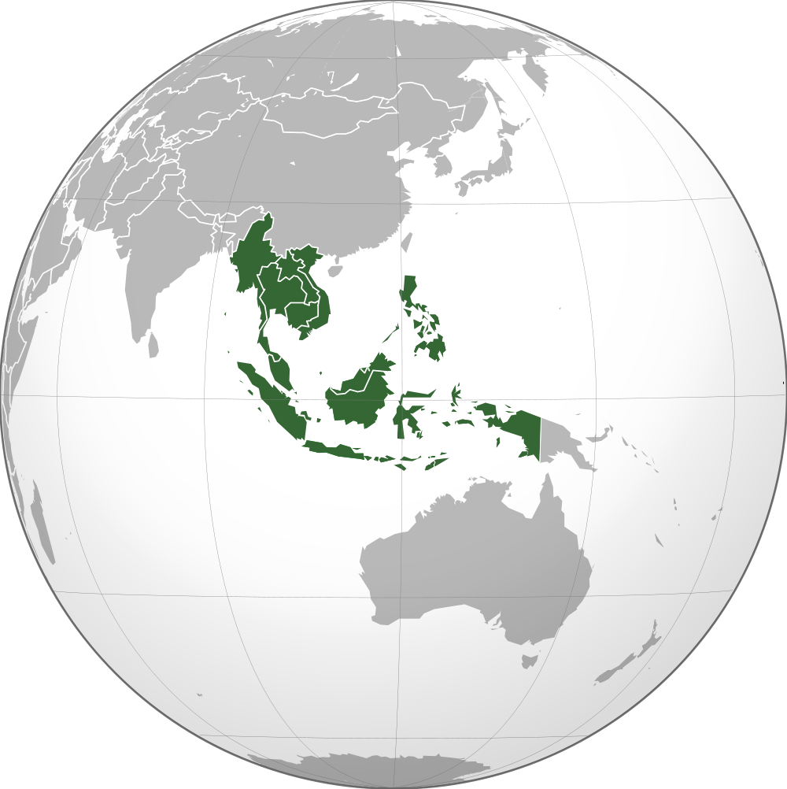

Slide 3
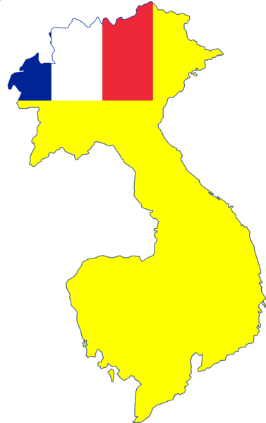
“French Indochina”
Vietnam had previously been known as “French Indochina” because it was a colony of France.
After WWII, Communist leader Ho Chi Minh led a rebellion against the French to try and help his country become independent.

Slide 4
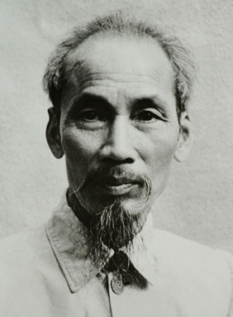
Ho Chi Minh
Ho Chi Minh had actually studied the American Revolution and was inspired by the Declaration of Independence.
He had attempted to gain American support for an independence movement and even had the support of President Roosevelt during WWII.

Slide 5
Ho Chi Minh
Unfortunately, Hi Chi Minh had also studied and was inspired by communist writings.
Roosevelt’s death and the beginning of the Cold War after WWII meant that he would not receive American support.
Ho Chi Minh began a revolutionary struggle against French forces for independence.

Slide 6
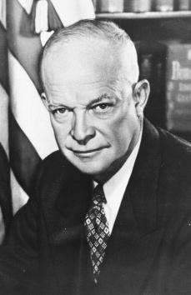
President Eisenhower
Vice President Richard Nixon had urged President Eisenhower to send American forces in right away to help the French and stop the spread of communism.
Eisenhower refused. He had been a five star general, and was wary about sending more American troops to fight and die in a complex war.

Slide 7
President Eisenhower
Still, Eisenhower was first to propose the so-called “domino theory” – that the fall of one country in Asia to communism would surely lead to another, and then another – like a chain of dominos.
He sent a handful of American military advisors as well as aid to help the non-communist south.

Slide 8
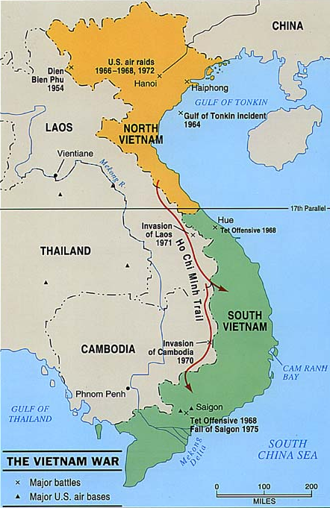
Dien Bien Phu
In 1954, Ho Chi Minh’s communist forces – the Viet Minh – finally defeated French colonial forces at the battle of Dien Bien Phu.
Soon after, the 1954 Geneva Conference divided Vietnam into two parts along the 17th Parallel. The north fell under communist control, while the south remained free.

Slide 9
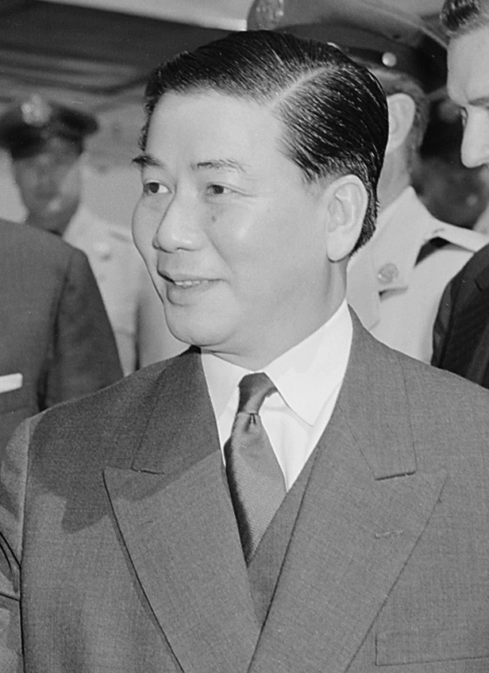
South Vietnam
Under the agreement of the 1954 Geneva Conference, the South part of Vietnam was supposed to allow free elections so the people could decide whether or not to unify with the communist north.
Fearing that he would lose power, however, the leader of South Vietnam Ngo Dinh Diem rigged the elections so he would win.

Slide 10
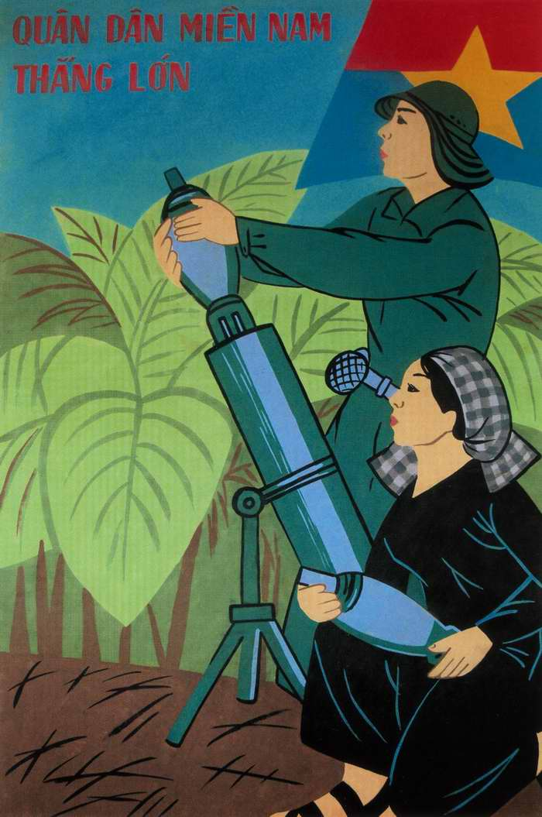
Civil War in Vietnam
Unable to unite the north and south through democratic means, communist forces clashed with South Vietnamese forces, setting off a civil war that would rage on into the 1960s.
American involvement would remain limited to money, supplies, and a few advisors until 1964…

